Slide 1
Doing more with less: Practical AI moves for procurement teams in 2026
Week of April 6th
Elias Hord

Slide 2
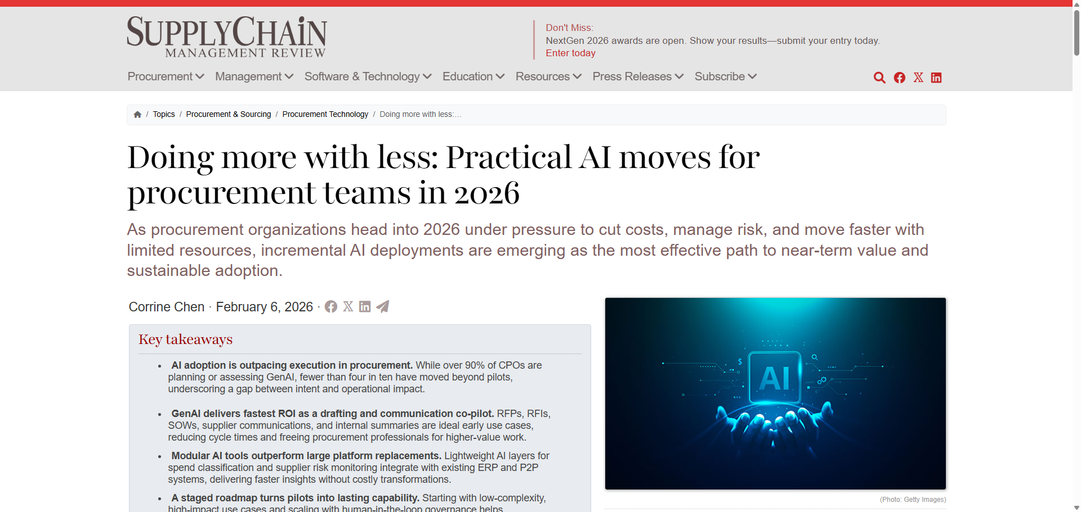
General Information
Article Publication: February 6th, 2026
https://www.scmr.com/article/doing-more-with-less-practical-ai-moves-for-procurement-teams-in-2026

Slide 3
Main Findings and Arguments
Procurement teams must “do more with less” in 2026 Organizations are facing tighter budgets, increased expectations, and ongoing supply chain volatility, pushing procurement teams to find efficiency without major system overhauls.
Practical, modular AI use cases deliver the most value Instead of large, complex AI transformations, the article argues for targeted applications that can be implemented quickly and show measurable ROI:
Generative AI for drafting documents (RFPs, contracts)
Spend analytics to improve visibility and cost control
Supplier risk monitoring using real-time data signals
There is a gap between AI ambition and execution While most procurement leaders are exploring or planning AI adoption, relatively few have moved beyond pilot programs into full implementation.
AI augments—not replaces—procurement functions The goal is not to rip out existing systems or eliminate jobs, but to enhance decision-making and efficiency within current workflows.
Continuous data-driven insights are key AI enables ongoing monitoring of supplier risk (financial, geopolitical, ESG), allowing teams to anticipate disruptions rather than react to them.

Slide 4
Broader Implications for Society
Shift toward efficiency-driven work environments Many industries—not just procurement—are adopting AI to maximize output with fewer resources, reinforcing a broader trend of lean, tech-enabled operations.
Workforce transformation rather than elimination AI is reshaping roles by automating repetitive tasks and pushing workers toward higher-value activities like strategy, analysis, and relationship management.
Increased reliance on data and transparency Real-time monitoring and predictive analytics mean organizations depend more heavily on data quality, governance, and digital infrastructure.
Greater resilience in global systems AI-enabled early warning systems for supply chains can reduce the societal impact of disruptions (e.g., shortages, price spikes).

Slide 5
Relevance or Potential Influence on the Construction Industry
Improved material procurement and cost control Construction firms can use AI-driven spend analytics to:
Track material costs (steel, concrete, lumber)
Identify savings opportunities
Optimize supplier selection
Enhanced supply chain risk management With construction heavily dependent on global suppliers, AI tools can:
Detect risks (delays, geopolitical issues, supplier instability)
Prevent project disruptions and cost overruns
Faster and more efficient contract management Generative AI can automate:
Bid documents
Subcontractor agreements
RFIs and project documentation → reducing administrative workload and speeding up project timelines
Better decision-making on large-scale projects AI insights allow construction managers to make data-driven sourcing decisions, improving project planning and execution.
Scalable digital transformation without major system replacement The article’s emphasis on modular AI adoption is especially relevant to construction, where firms often rely on legacy systems and need incremental upgrades rather than full overhauls.

